Slide 1
Employee Management System
Prepared By : -
Name : - Pal Vishalbhai Trivedi
Enrollment No. : - 23002171210185
Roll No. : - 6
Batch : - B1
Branch : - CSE

Slide 2


Employee Management System
Welcome to the Employee Management System, a comprehensive platform designed to streamline and enhance employee management processes. This system offers a user-friendly interface for both administrators and employees, providing a range of functionalities to manage employee information, assign tasks, track progress, and more.

Slide 3
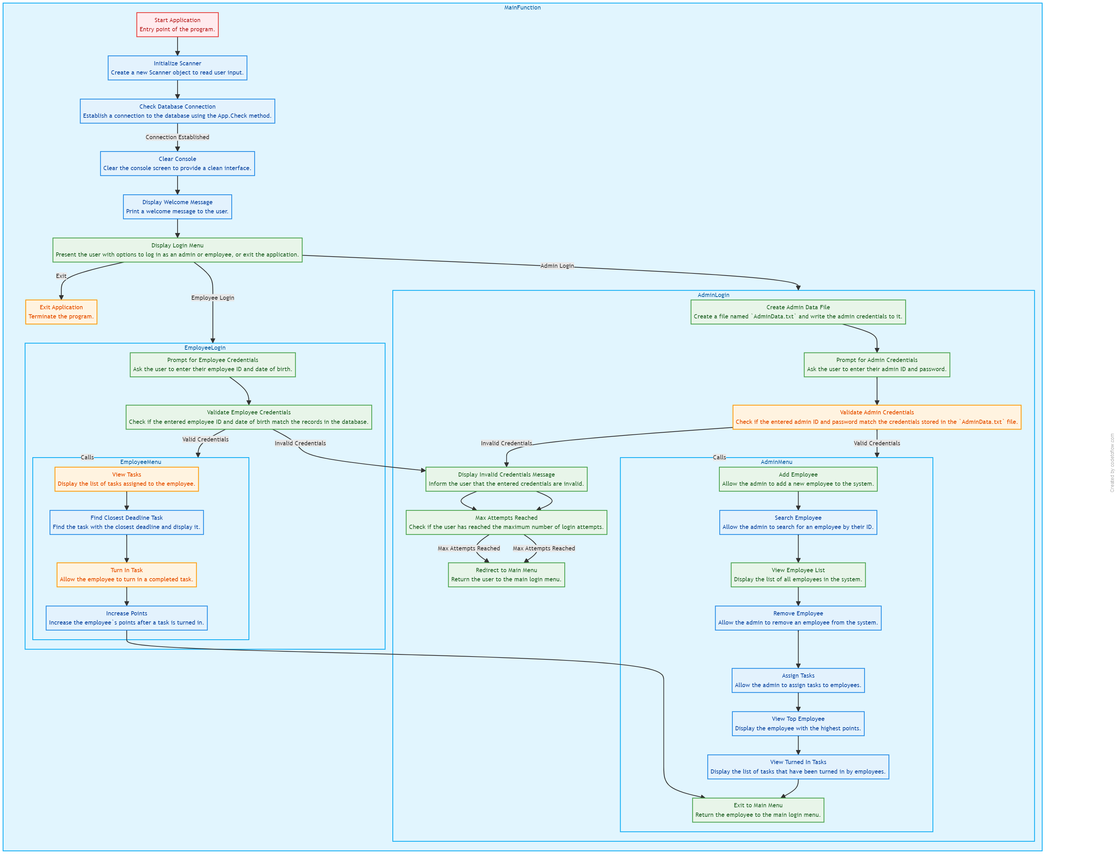
Flowchart : -

Slide 4
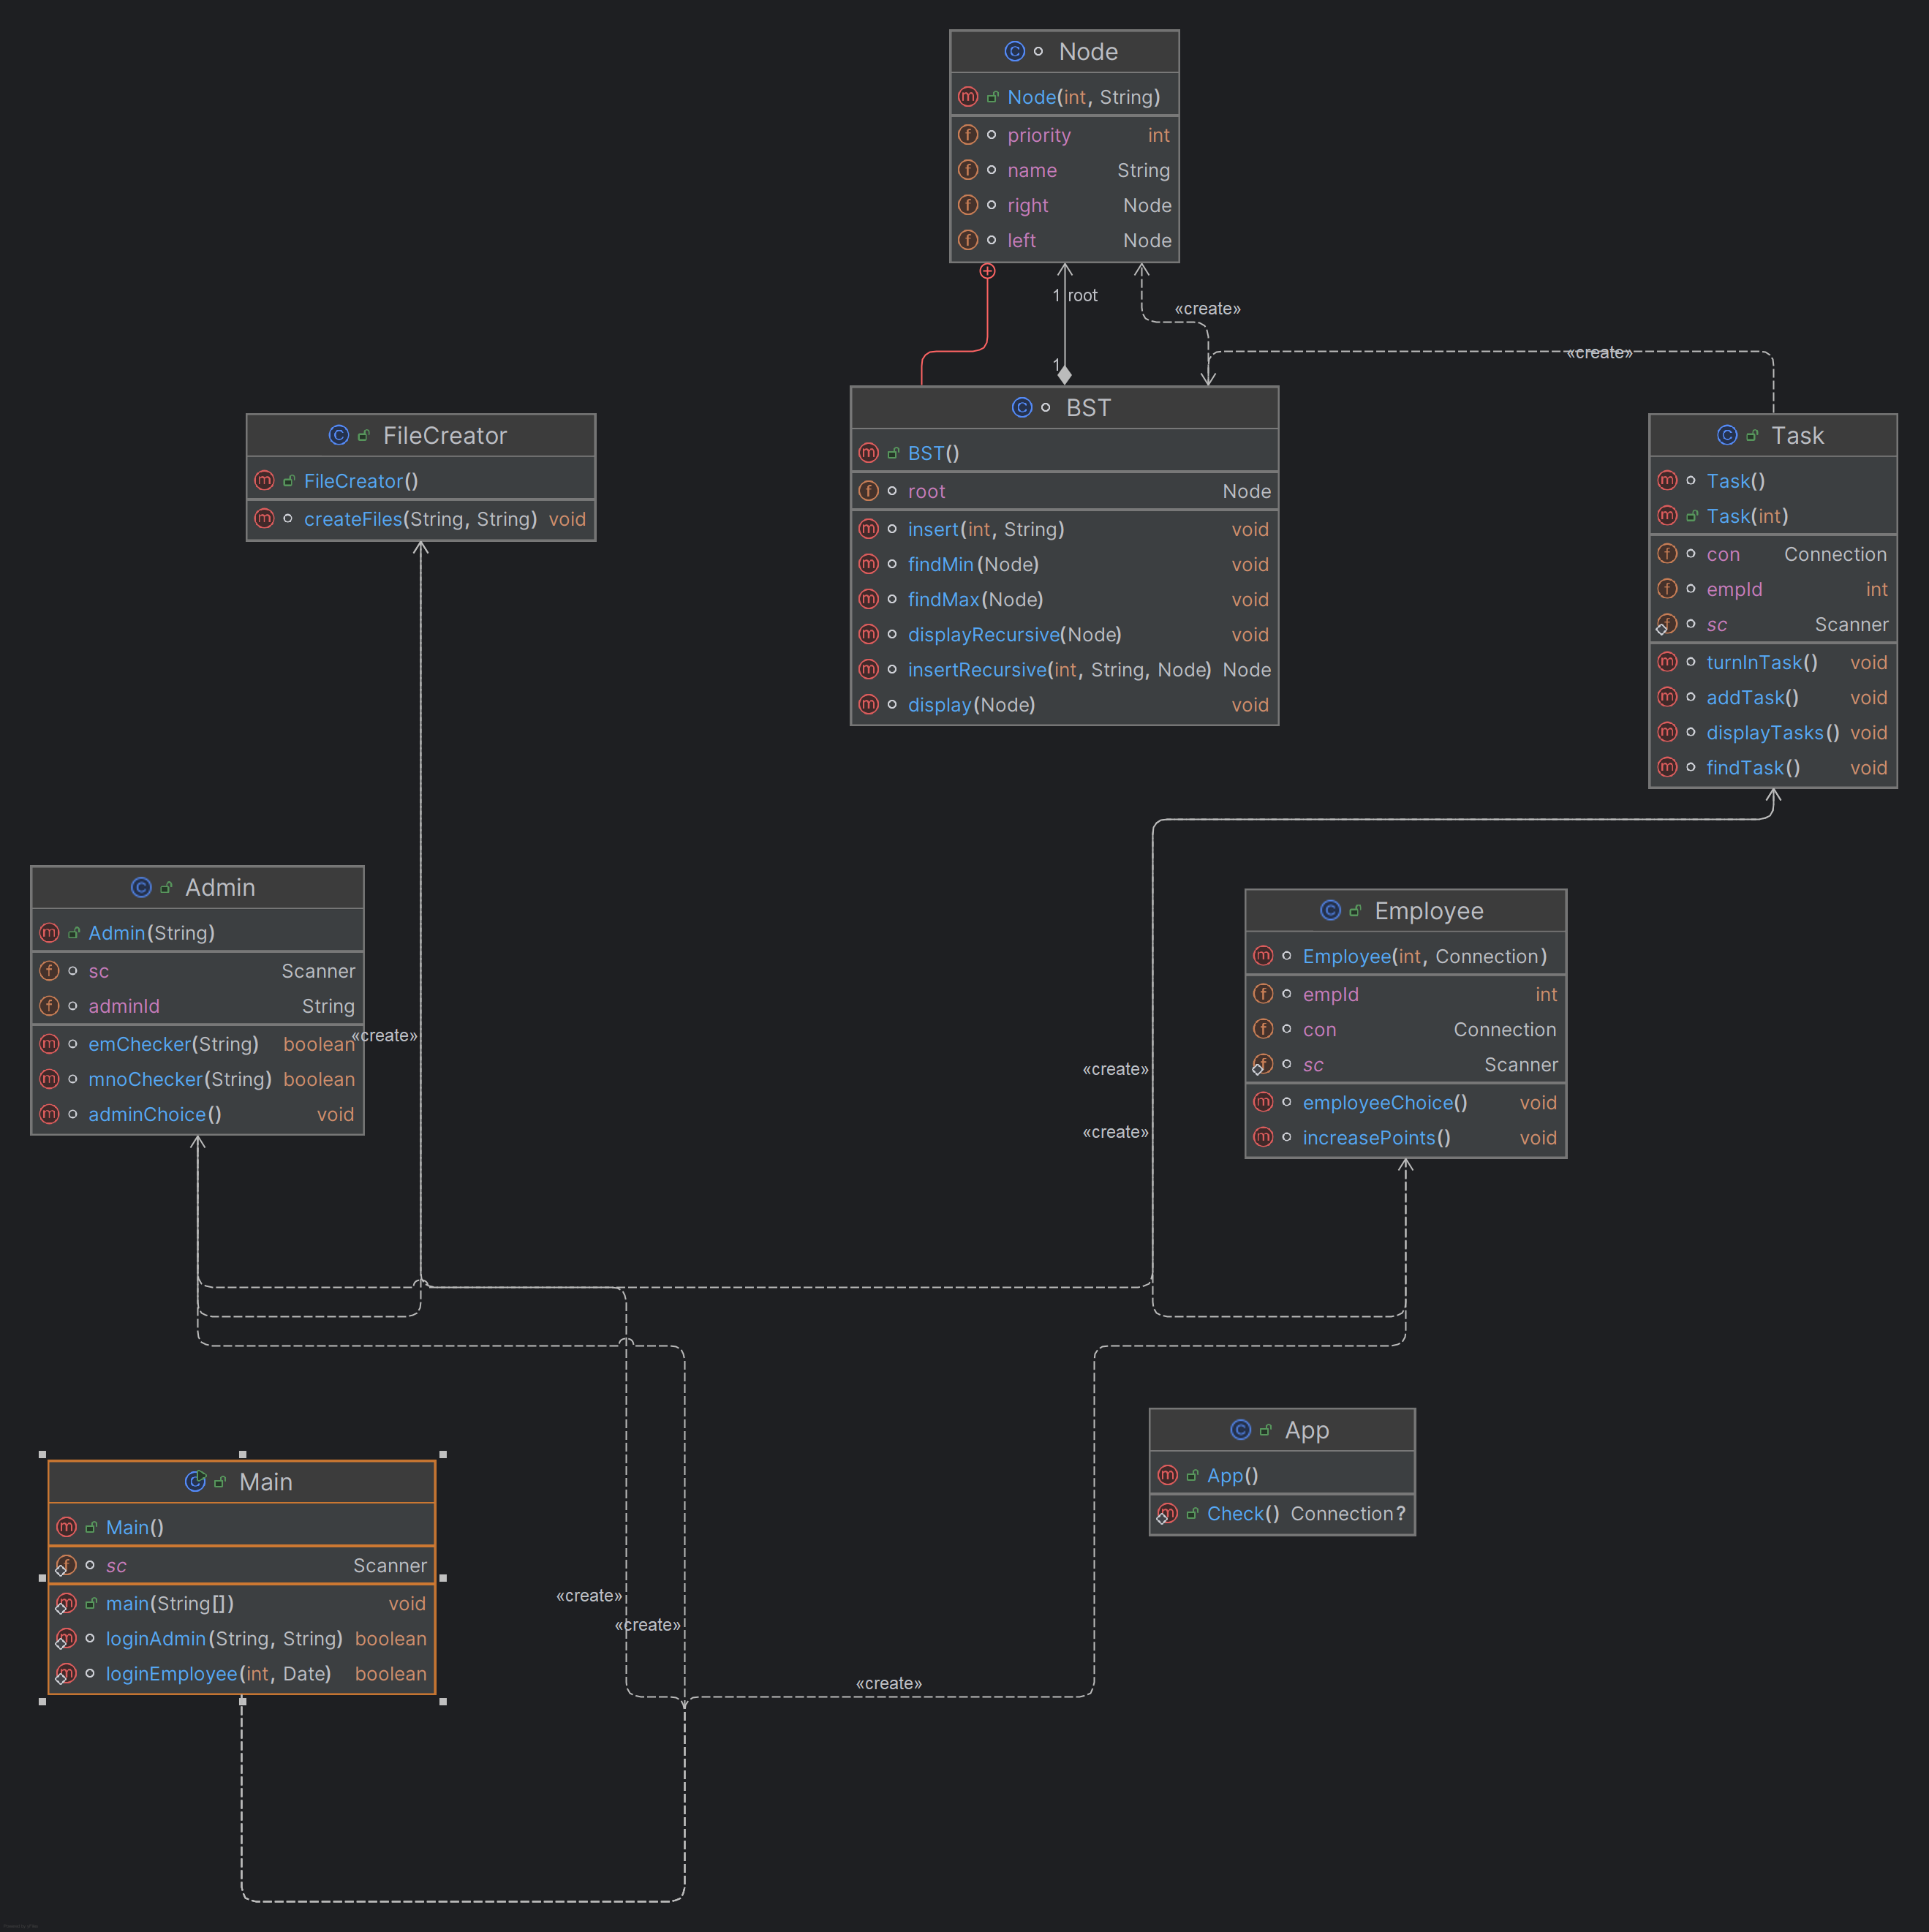
Class Diagram : -

Slide 5
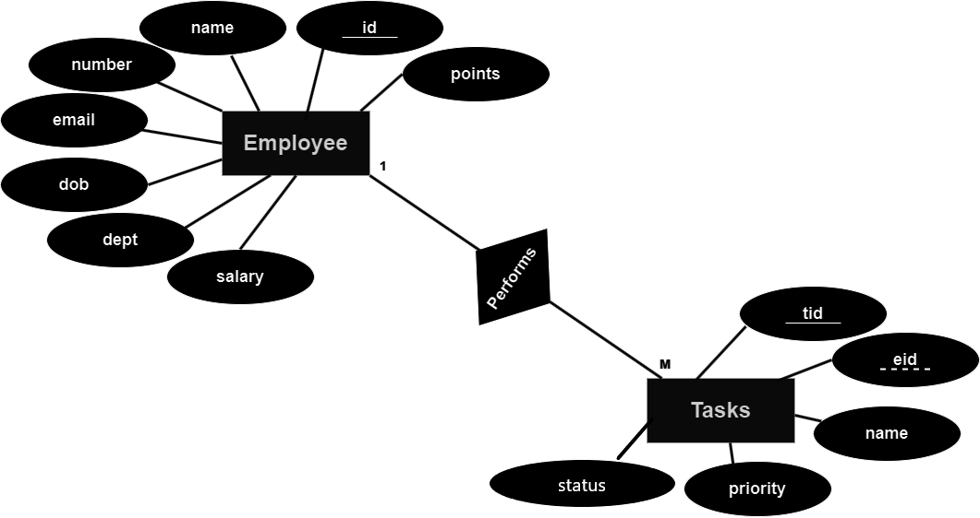
Entity-Relationship Diagram : -

Slide 6
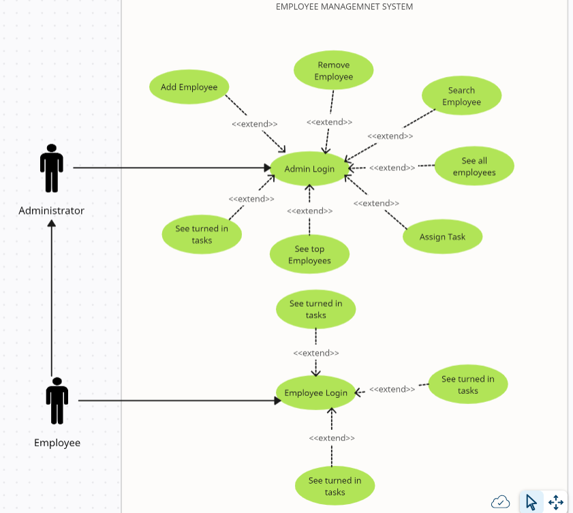
Use Case Diagram : -

Slide 7

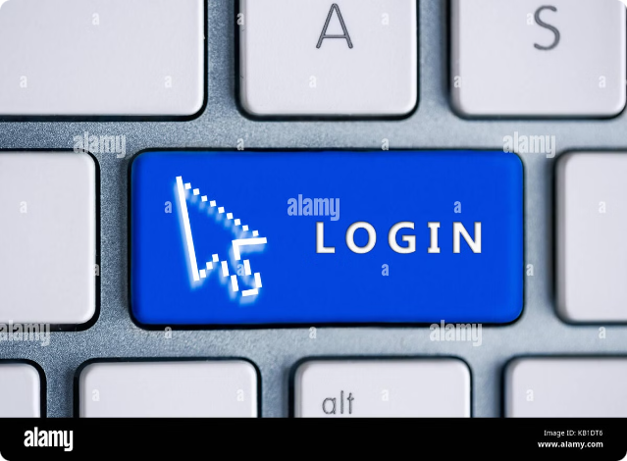
Functionalities : -
1
Admin Login
Add Employee
Search Employee
See Employee List
Remove Employee
Assign Tasks
See Top Employee
See Turned In Tasks
2
Employee Login
See all Tasks
See Task with Closest Deadline
Turn in Task
3
Exit
This option allows users to exit the system.

Slide 8
Data Structures | JAVA | DBMS
Latest Turned in task(through stack) | Exception handling for logins | DML queries for updation, deletion and insertion in the database
Stack implemented using Linked list | JDBC for database access and connectivity | Functions for login of Employee
Storing and going through retrieved data(using arrays) | File Handling for retrieving and storing data into txt files | Primary keys to retrieve unique tuples and Foreign key to establish link between tables
Tasks with closest deadline(through BST) | Conditional statements and loops | Procedures for increasing points and to turn in tasks

Slide 9

Merits
Demerits
Improved Productivity
Initial Investment
Employee Management System helps to streamline tasks and projects, allowing employees to focus on high-priority tasks.
Implementing an Employee Management System requires a significant upfront investment in software, hardware, and training.
Enhanced Task Management
Dependence on Technology
The system relies on technology, which can be prone to errors, glitches, and downtime.
The system enables employees to create, assign, and track tasks efficiently.
Efficient Time Management
Security Risks
The system helps employees prioritize tasks and manage their time more effectively.
The system stores sensitive employee data, which is vulnerable to cyber threats and data breaches.

